Slide 1
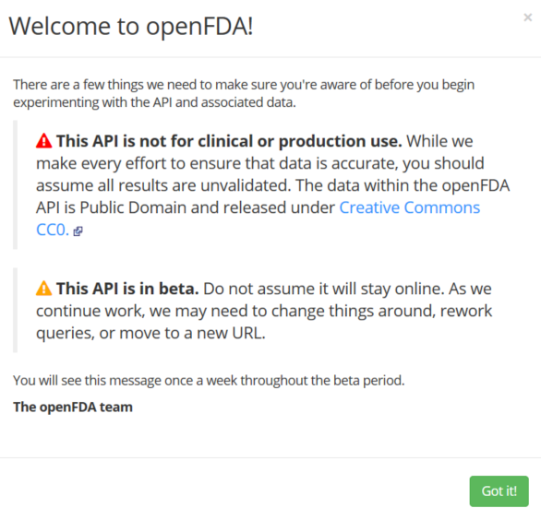
User entrance and app-logic / flow:
Home / landing page.
App description.
API usage
Simple instructions
Search Topics Label & Adverse Effects
User select 1 of 3 search criteria.
Prescription Drugs
FDA Food
Prescription Drugs > Label display (Section 508)
User is presented form elements for input / selection.
User submits criteria for query results.
Results viewing elements:
Display elements per criteria choices
Map
Label
Text Content / related information.
User entrance presents usage alert:
API & Usage Alert [ openFDA modal presentation ].

Slide 2
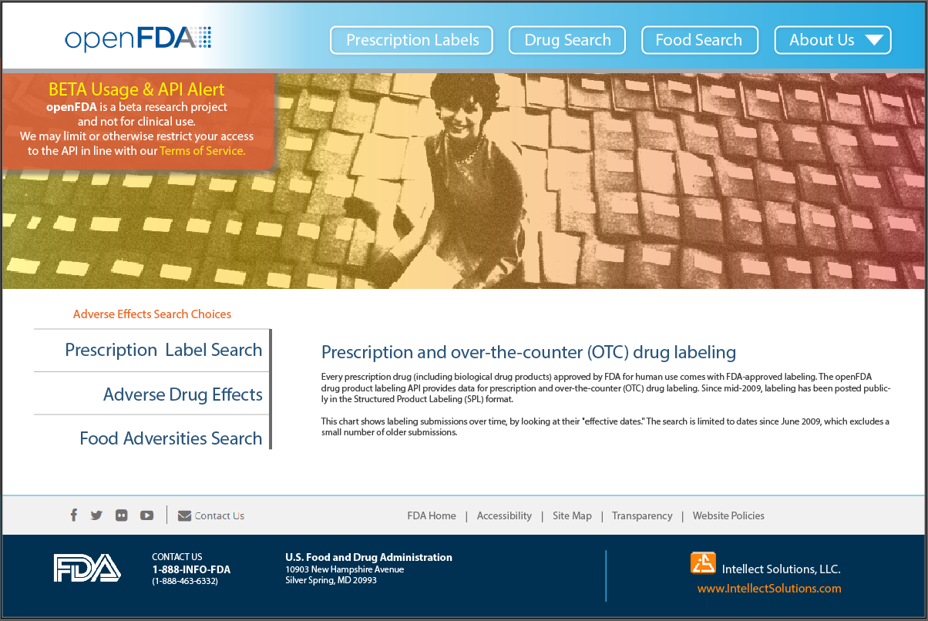
Home / landing page.
User entrance and app-logic / flow:
API warning / usage (modal).

Slide 3
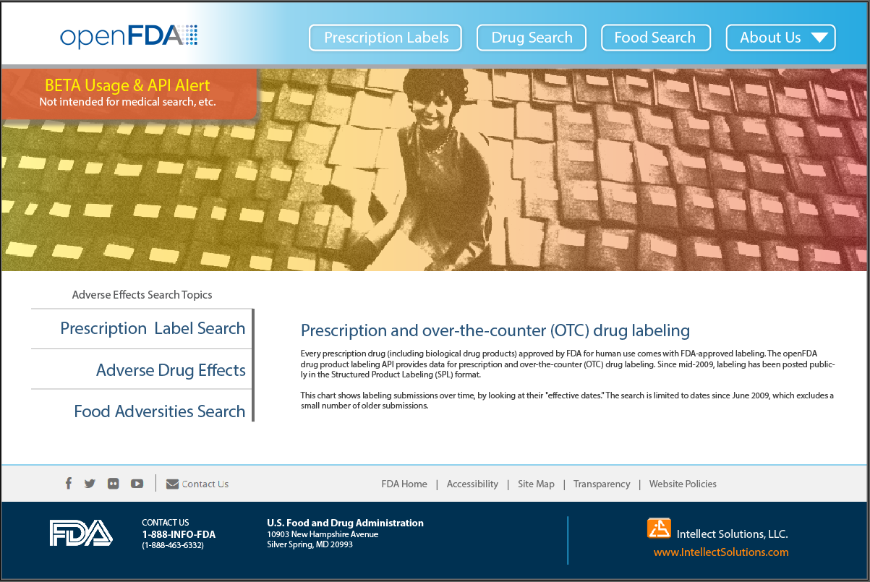
User entrance and app-logic / flow:
API warning / usage.

Slide 4
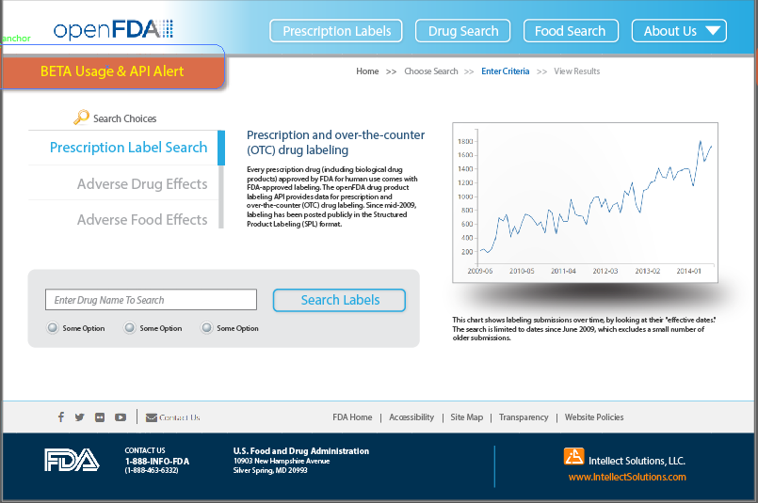
Search Topics: Label & Adverse Effects
Prescription Labels

Slide 5
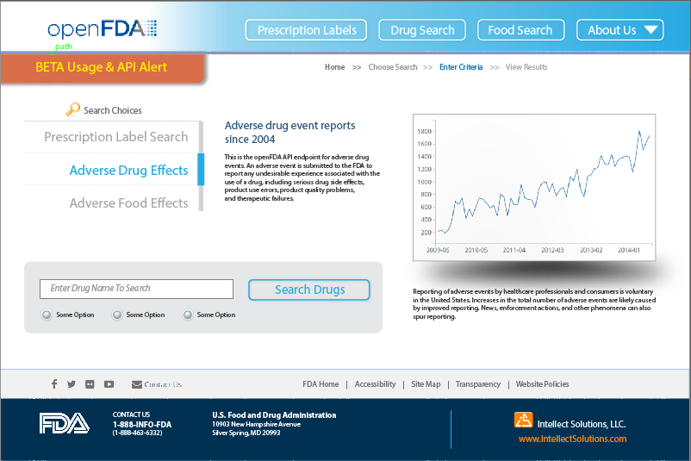
Search Topics: Label & Adverse Effects
Prescription Drugs

Slide 6
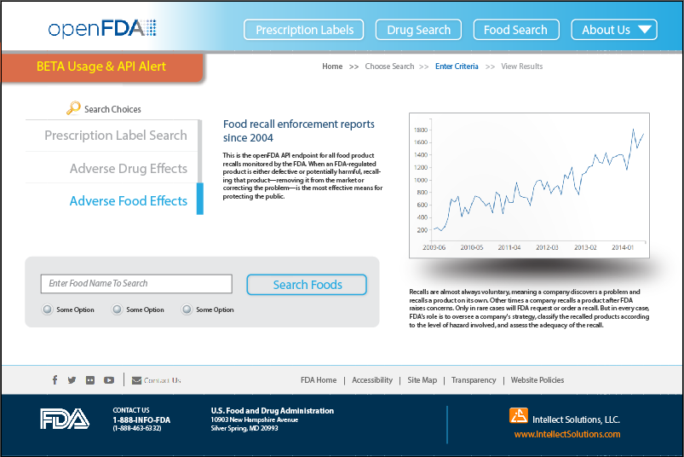
Search Topics Label & Adverse Effects
FDA Food Reporting

